Slide 1
STATEMENTS, CONTROL STRUCTURES AND SCOPE

Slide 2
JAVA STATEMENTS
Java statements can be classified as:
Single statements: have one statement that maybe of assignment expressions, any use of ++ or --, method calls, object creation expressions.
Control flow statement (if/switch/ for/ while/ do while/ break/ continue etc)
Null or empty statement (just a semicolon (;))
Block Statement is a group of zero or more single statements enclosed between two balanced braces ({}).
For Example:
if (a>b)
{
z=a+b;
String b=new String (“Test”);
if (z>0)
{
System.out.println (“z is a positive integer”);
}
}

Slide 3
CONTROL STRUCTURES
Selection Statements
Iteration Statements
Jump Statements

Slide 4
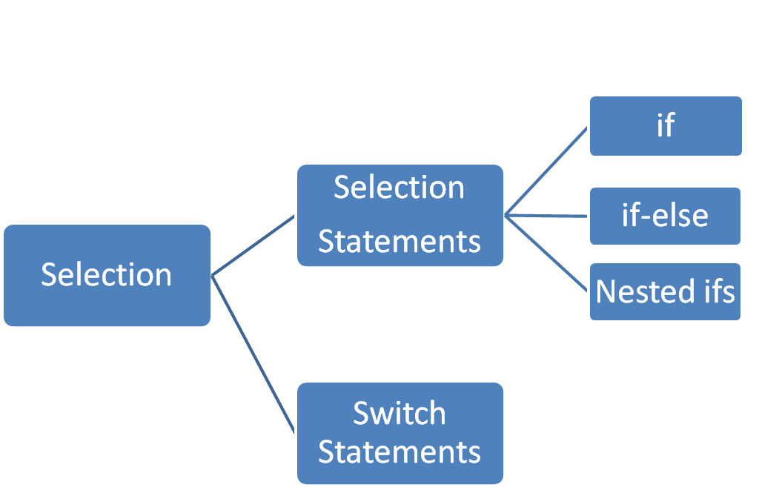
SELECTION STATEMENTS

Slide 5
if Statement
Syntax:
if (expression)
statement;
// Java program to illustrate If statement
class ifexample
{
public static void main(String args[])
{
int i = 10;
if (i < 15)
System.out.println("10 is less than 15");
System.out.println("Outside if-block");
// both statements will be printed
}
}
Output
10 is less than 15
Outside if-block

Slide 6
if else Statement
Syntax:
if (condition)
{
// Executes this block if condition is true
}
else
{
// Executes this block if condition is false
}

Slide 7
// Java program to illustrate if-else statement
class IfElseDemo {
public static void main(String args[])
{
int i = 20;
if (i < 15)
System.out.println("i is smaller than 15");
else
System.out.println("i is greater than 15");
System.out.println("Outside if-else block");
}
}
Output
i is greater than 15
Outside if-else block

Slide 8
WAP to check the number is even or odd
class ex2
{
public static void main(String args [] )
{
int n=34;
if (n%2==0)
System.out.println(n + “is even”);
else
System.out.println(n + “is odd”);
}
Output
34 is even

Slide 9
import java.util.Scanner;
class EvenOdd
{
public static void main(String[] args)
{
Scanner reader = new Scanner(System.in);
System.out.print("Enter a number: ");
int num = reader.nextInt();
if(num % 2 == 0)
System.out.println(num + " is even");
else
System.out.println(num + " is odd");
}
}

Slide 10
Nested ifs
Syntax:
if (expression)
statement;
// Java program to illustrate If statement
class ifexample
{
public static void main(String args[])
{
int i = 10;
if (i < 15)
System.out.println("10 is less than 15");
System.out.println("Outside if-block");
// both statements will be printed
}
}
Output
10 is less than 15
Outside if-block

Slide 11
WAP that accepts 2 numbers and lists their properties in following manner: whether the number is natural or whole number or an integer whether the number is even or odd whether the number is positive or negative whether the two numbers have equal absolution value

Slide 12
import java.util.Scanner;
public class Test
{
public static void main (String args[])
{
int a,b;
Scanner in=new Scanner (System.in);
System.out.print(“Enter 2 numbers”);
a=in.nextInt();
b=in.nextInt();
// Checking for first number
if(a>0)
{
if (a%2==0)
System.out.println(“First no is natural, even and positive no”);
else
System.out.println(“First no is natural, odd and positive no”);
}
else if (a==0)
System.out.println(“First no is whole no,zero”);

Slide 13
else
{ //negative integer check
if (a % 2==0)
System.out.println(“First no is integer, even and negative no”);
else
System.out.println(“First no is integer, odd and negative no”);
}
// Checking for second number
if(b>0)
{
if (b%2==0)
System.out.println(“Second no is natural, even and positive no”);
else
System.out.println(“Second no is natural, odd and positive no”);
}
else if (b==0)
System.out.println(“Second no is whole no,zero”);
else
{ //negative integer check
if (b % 2==0)
System.out.println(“Second no is integer, even and negative no”);
else
System.out.println(“Second no is integer, odd and negative no”);
}

Slide 14
// Comparing absolute values
if (Maths.abs(a) > Maths.abs(b))
System.out.println(“The first no has higher absolute value than second no”);
else if (Maths.abs(a) < Maths.abs(b))
System.out.println(“The second no has higher absolute value than first no”);
else
System.out.println(“Both have equal absolute values”);
}
}

Slide 15
Switch Statement
Instead of writing many if..else statements, you can use the switch statement.
The switch statement selects one of many code blocks to be executed:
Syntax
switch(expression)
{
case x:
// code block
break;
case y:
// code block
break;
default:
// code block
}
This is how it works:
The switch expression is evaluated once.
The value of the expression is compared with the values of each case.
If there is a match, the associated block of code is executed.

Slide 16
// The example below uses the weekday number to calculate the weekday name:
  public class Main {
  public static void main(String[] args) {
  int day = 4;
  switch (day) {
  case 1:
  System.out.println("Monday");
  break;
  case 2:
  System.out.println("Tuesday");
  break;
  case 3:
  System.out.println("Wednesday");
  break;
  case 4:
  System.out.println("Thursday");
  break;
  case 5:
  System.out.println("Friday");
  break;
  case 6:
  System.out.println("Saturday");
  break;
  case 7:
  System.out.println("Sunday"); *Output*
  Thursday
  break;
  }
  }
  }

Slide 17
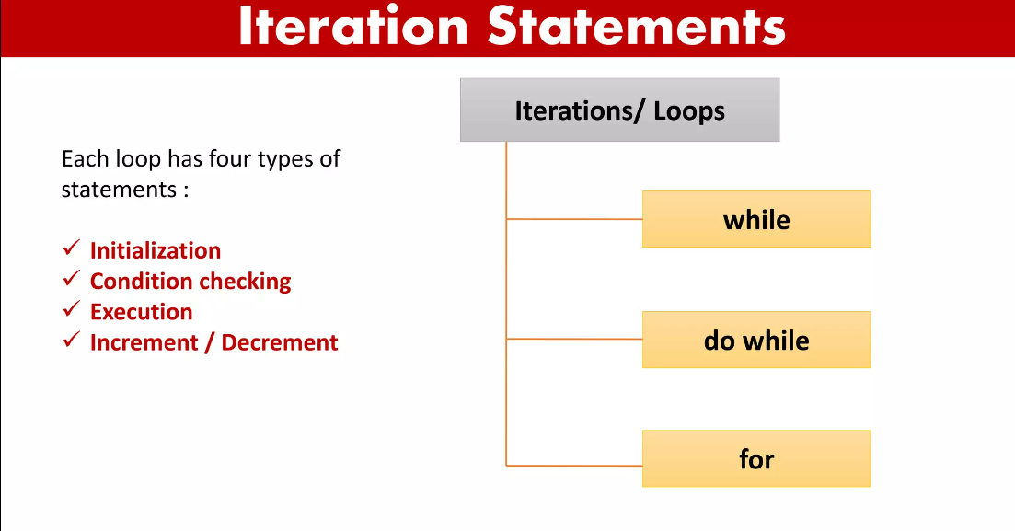

Slide 18
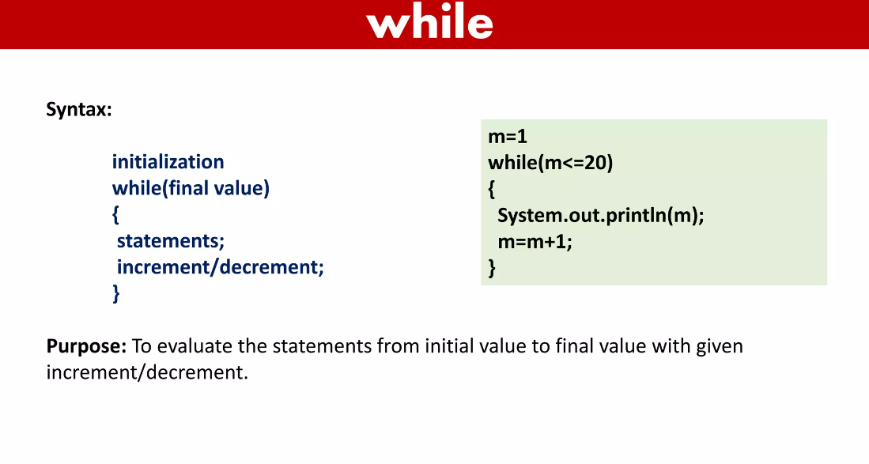

Slide 19
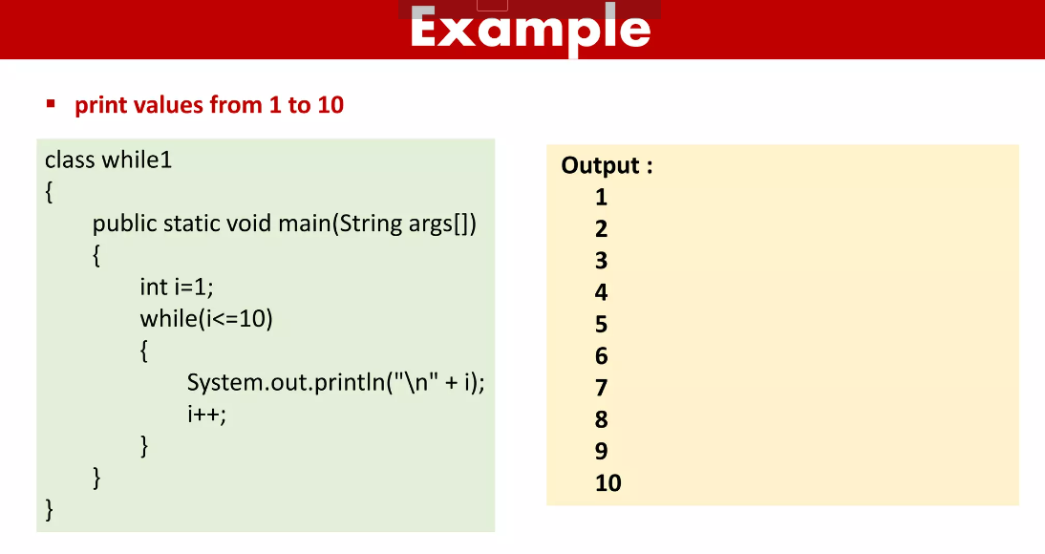

Slide 20
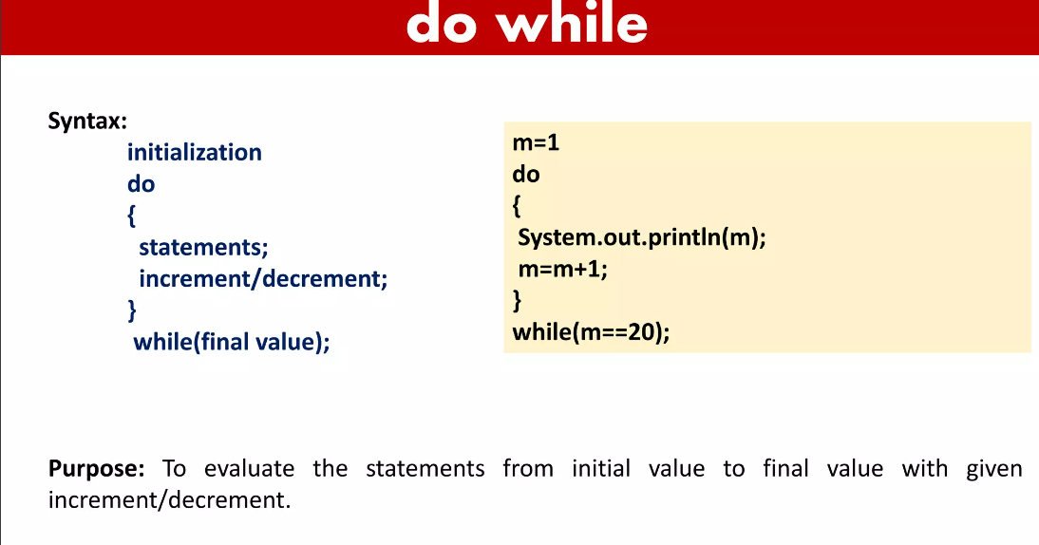

Slide 21
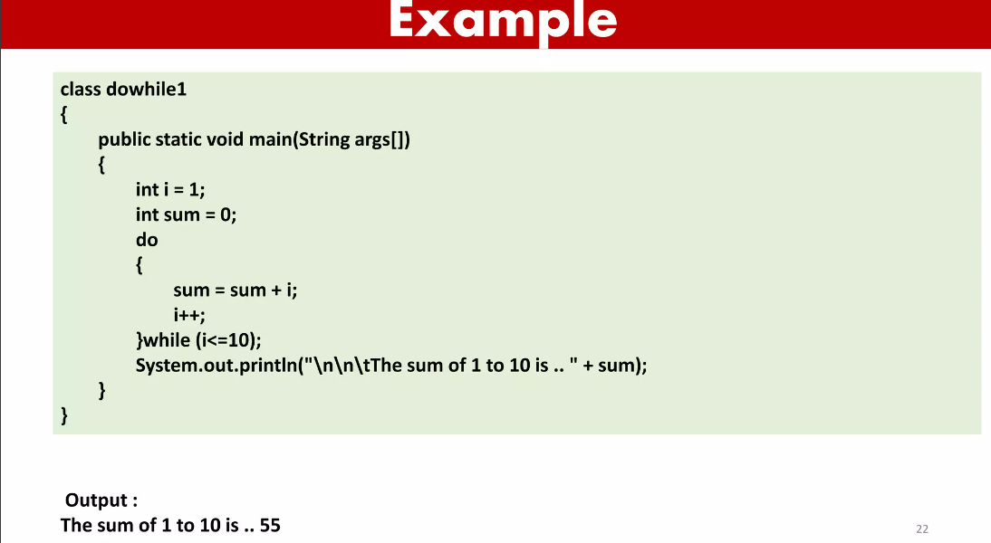

Slide 22
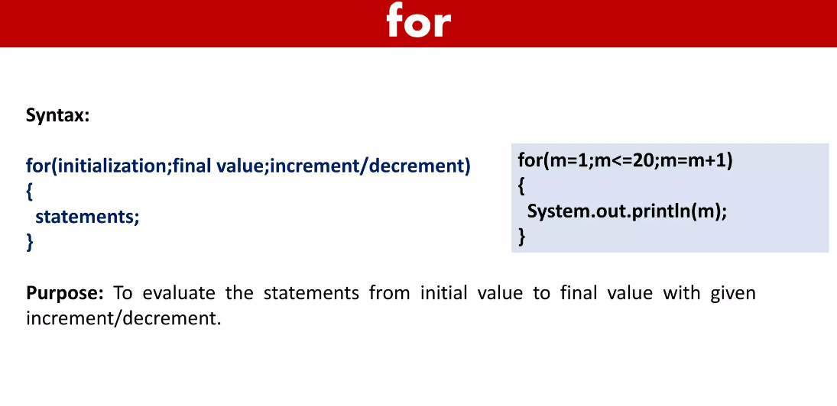

Slide 23
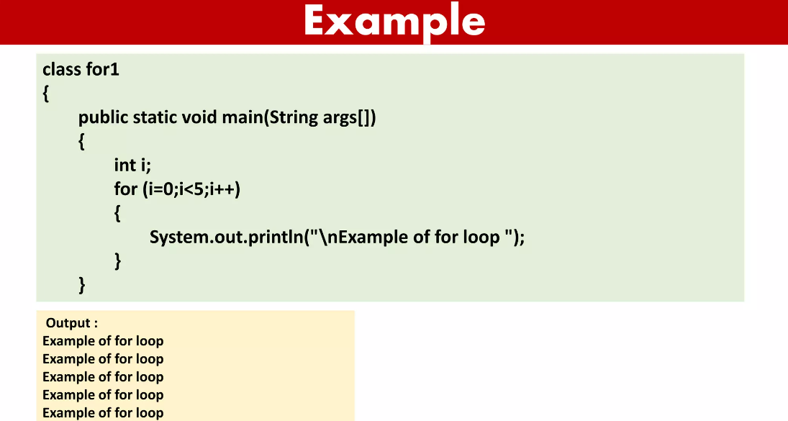

Slide 24
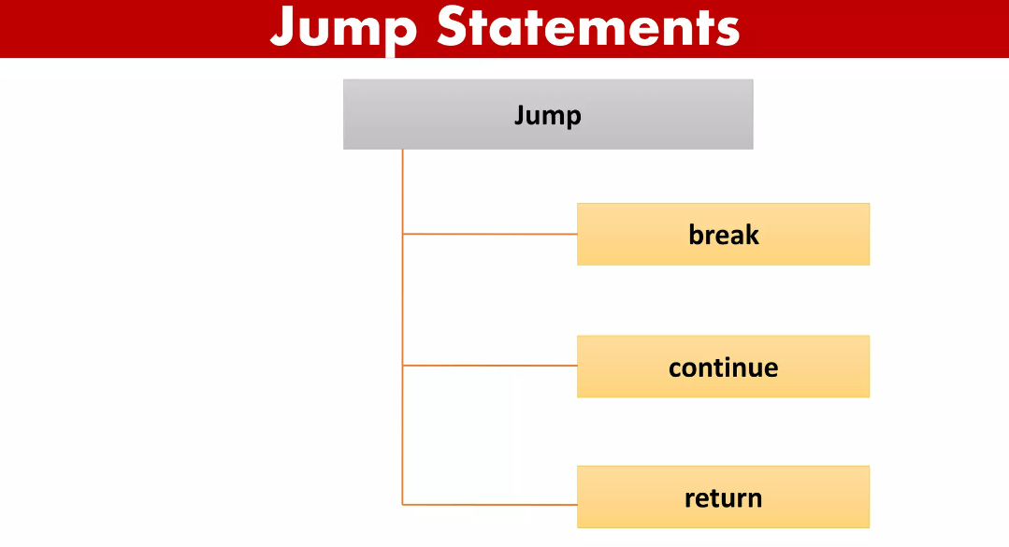

Slide 25
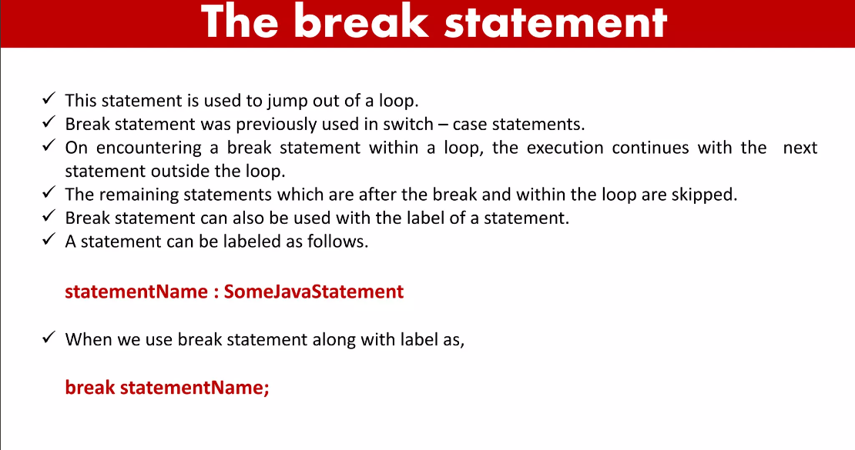

Slide 26
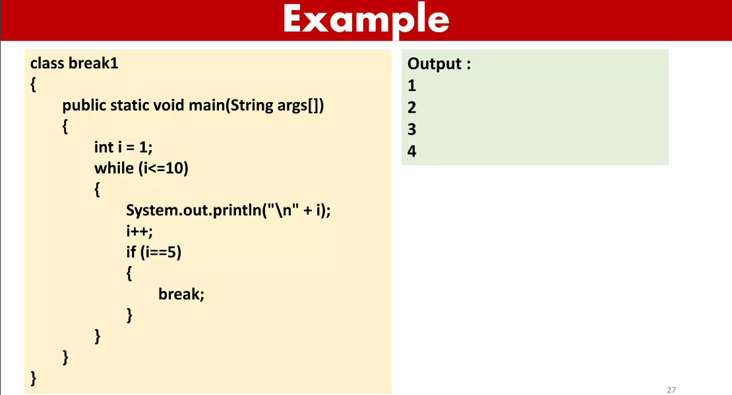

Slide 27
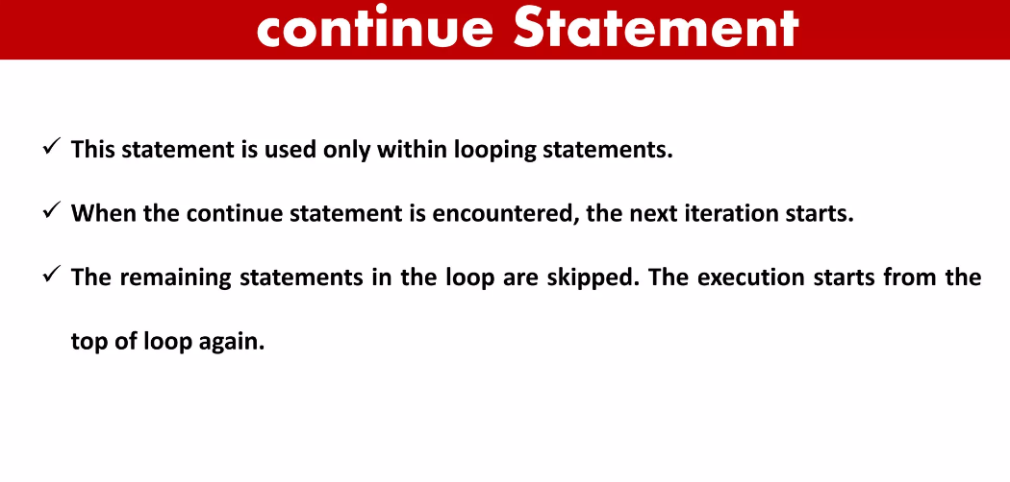

Slide 28
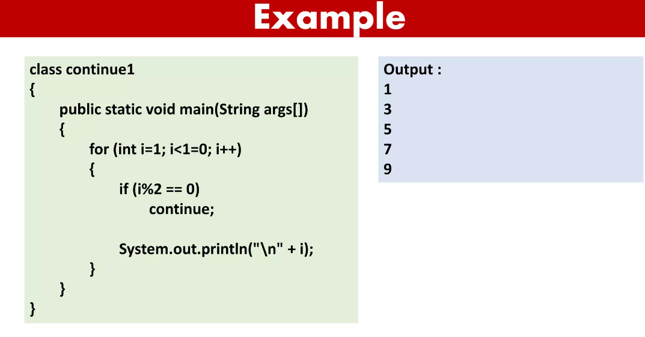

Slide 29
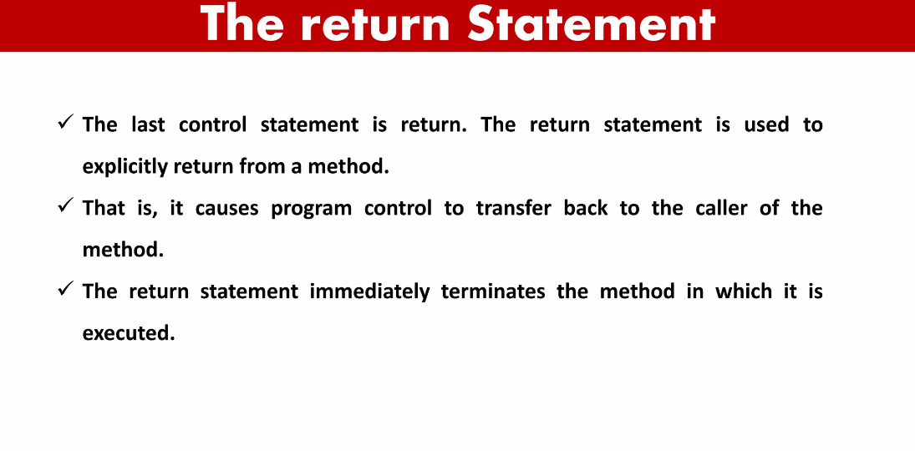

Slide 30
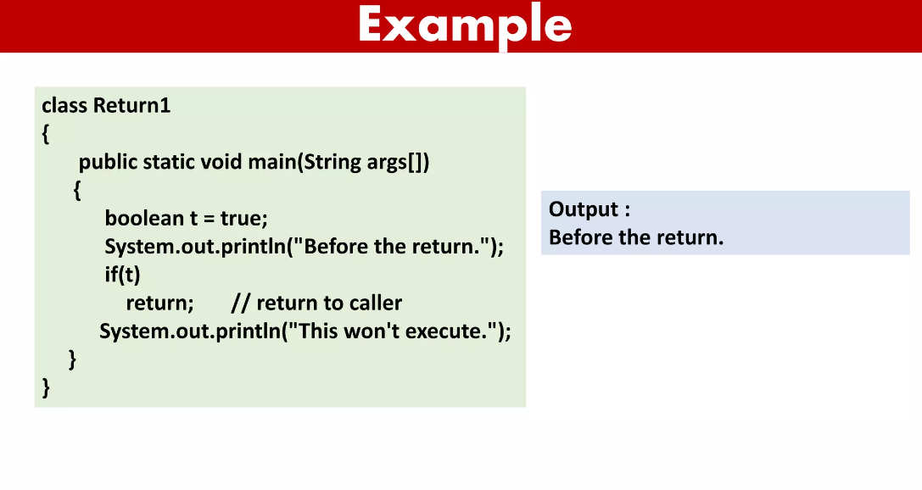

Slide 31
THANK YOU

